Slide 1
Social-Media Advertising Analysis

Slide 2
What The Secret Behind Successful Online Businesses?
1.
Social Media Ads
2.
Golden Audience
3.
Platform Selection
4.
Timing is Money
5.
Winning Formula
6.
Expected Results
7.
Thank you !

Slide 3

DATA
ROI
LOCATION
LANGUAGE
CLICKS
IMPRESSIONS
ENGAGEMENT_SCORE
CUSTOMER_SEGMENT
DATE
COMPANY
CTR
CAMPAIGN_ID
GENDER
AGE GROUP
CAMPAIGN_GOAL
DURATION
CHANNEL_USED
CONVERSION_RATE
ACQUISITION_COST
PERFORMANCE TIER

Slide 4
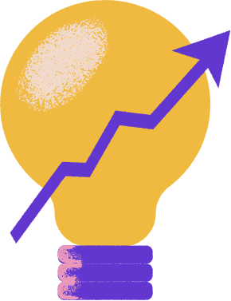
Social Media Ads
1. UNFOCUSED ADVERTISING CAMPAIGNS
2. CHOOSING THE WRONG PLATFORMS
3. POOR TIMING STRATEGY

Slide 5
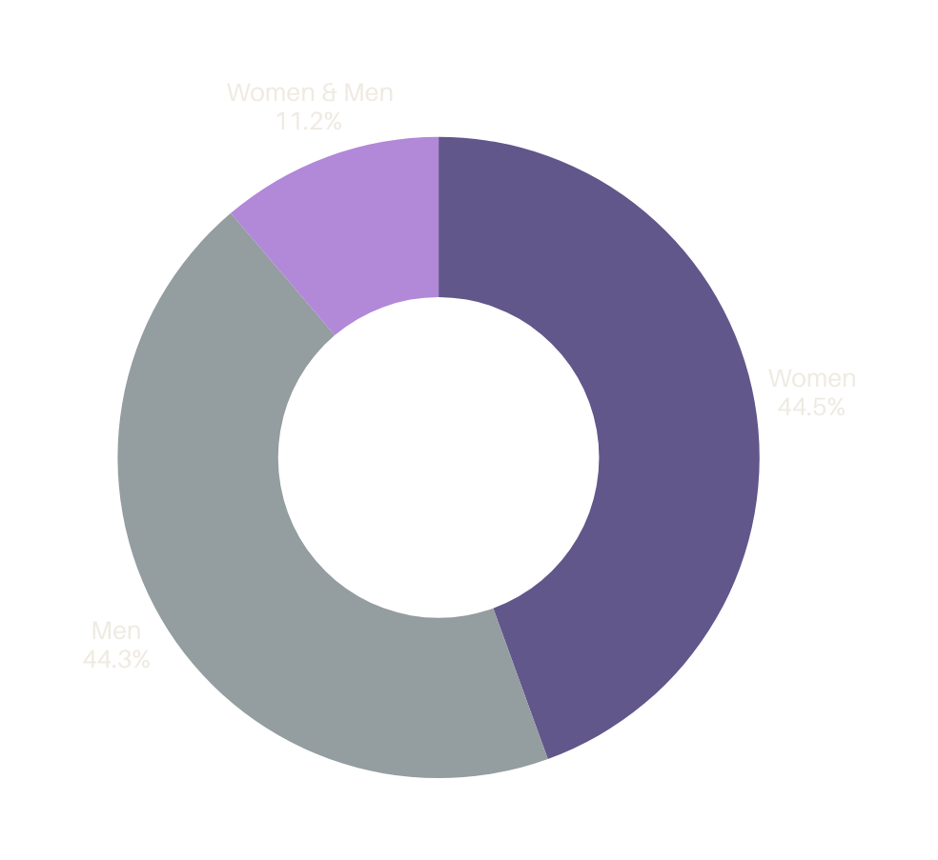
Golden
Audience
IDENTIFYING HIGH-VALUE SEGMENTS
BEHAVIOR & INTEREST TARGETING
LOOKALIKE AUDIENCES

Slide 6

Platform Selection
Choose platforms where your target audience is most active
Engagement Rate

Slide 7
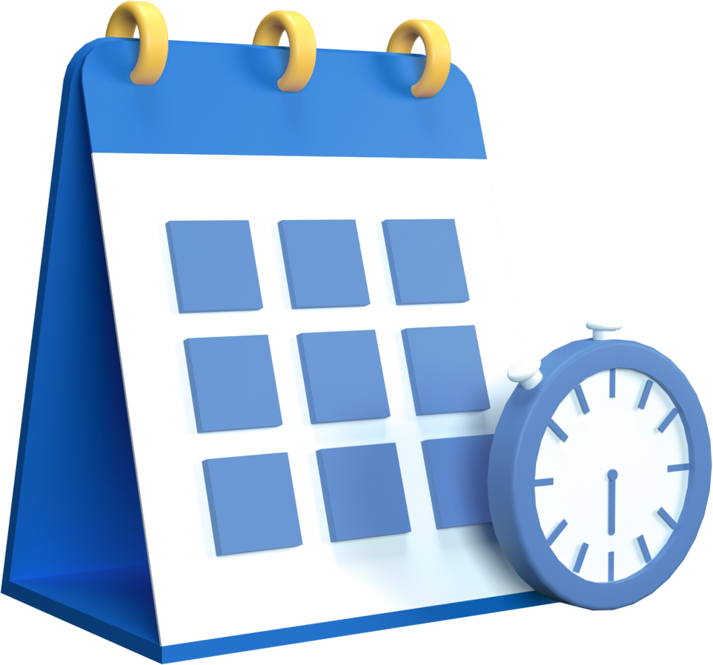
Timing is Money
Peak Months Analysis
Day & Hour Optimization
Seasonal Trends
Avoiding Low-Performance Periods

Slide 8
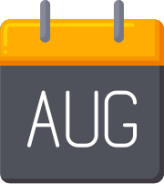


Winning Formula
3 STEPS TO IMPROVE:
BOOST IN AUGUST"
FOCUS ON INSTEGRAM
TARGET WOMEN 35-44

Slide 9
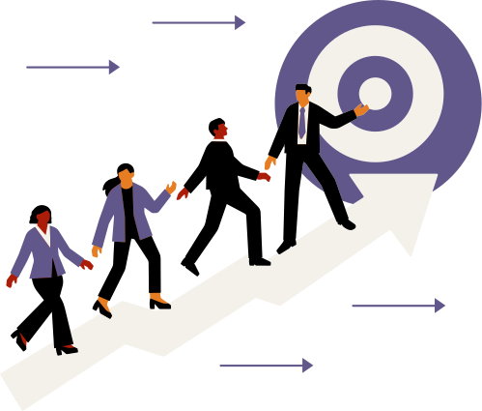
Expected Results
HIGHER ROI
BETTER ENGAGEMENT
INCREASED CONVERSIONS
REDUCED WASTED SPEND

Slide 10
Thank you

